Slide 1
Control Statements
Eric Roberts
CS 106A
January 15, 2010

Slide 2
Once upon a time . . .

Slide 3
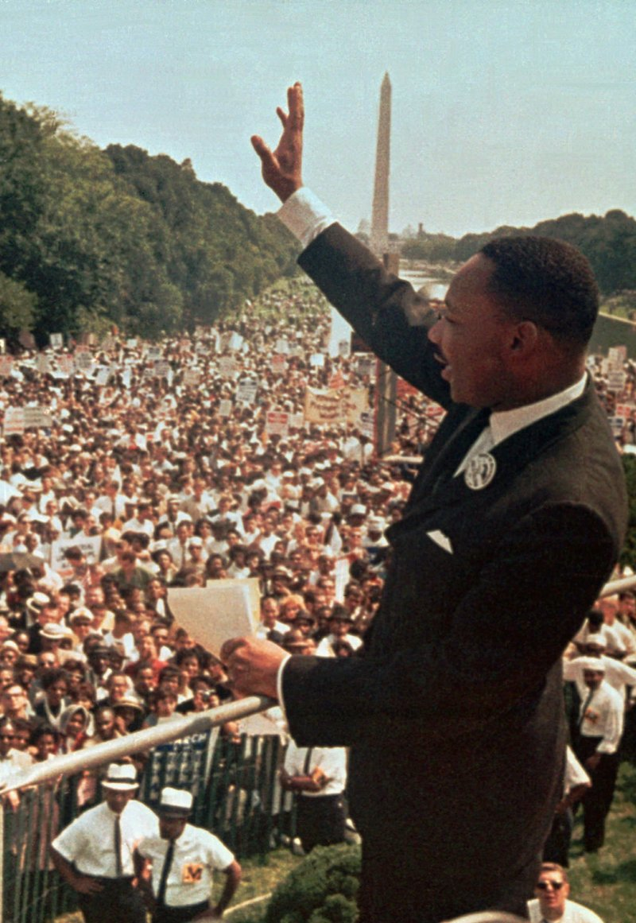
Optional Movie
And so even though we face the difficulties of today and tomorrow, I still have a dream. It is a dream deeply rooted in the American dream.
I have a dream that one day this nation will rise up and live out the true meaning of its creed: “We hold these truths to be self-evident, that all men are created equal.”
Martin Luther King, Jr.
“I Have a Dream”
Gates B-12
Monday, January 18
3:15 P.M.

Slide 4
Control Statements

Slide 5
The GObject Hierarchy
The classes that represent graphical objects form a hierarchy, part of which looks like this:
GObject
GLabel
GRect
GOval
GLine
The GObject class represents the collection of all graphical objects. The four subclasses shown in this diagram correspond to particular types of objects: labels, rectangles, ovals, and lines. The class diagram makes it clear that any GLabel, GRect, GOval, or GLine is also a GObject.
Operations on graphical objects are defined at each level of the hierarchy. Operations that apply to all graphical objects are specified at the GObject level, where they are inherited by each subclass. Operations that apply to a particular subclass are specified as part of the definition of that class.

Slide 6
Operations on the GObject Class
The following operations apply to all GObjects:
object.setColor(color)
Sets the color of the object to the specified color constant.
object.setLocation(x, y)
Changes the location of the object to the point (x, y).
object.move(dx, dy)
Moves the object on the screen by adding dx and dy to its current coordinates.
The standard color names are defined in the java.awt package:
Color.BLACK
Color.DARK_GRAY
Color.GRAY
Color.LIGHT_GRAY
Color.WHITE
Color.RED
Color.YELLOW
Color.GREEN
Color.CYAN
Color.BLUE
Color.MAGENTA
Color.ORANGE
Color.PINK

Slide 7
Operations on the GLabel Class
Constructor
new GLabel(text, x, y)
Creates a label containing the specified text that begins at the point (x, y).
Methods specific to the GLabel class
label.setFont( font)
Sets the font used to display the label as specified by the font string.
The font is typically specified as a string in the form
"family-style-size"
where
family is the name of a font family
style is either PLAIN, BOLD, ITALIC, or BOLDITALIC
size is an integer indicating the point size

Slide 8
Drawing Geometrical Objects
Constructors
new GRect( x, y, width, height)
Creates a rectangle whose upper left corner is at (x, y) of the specified size.
new GOval( x, y, width, height)
Creates an oval that fits inside the rectangle with the same dimensions.
new GLine( x₀, y₀, x₁, y₁)
Creates a line extending from (x₀, y₀) to (x₁, y₁).
Methods shared by the GRect and GOval classes
object.setFilled( fill)
If fill is true, fills in the interior of the object; if false, shows only the outline.
object.setFillColor( color)
Sets the color used to fill the interior, which can be different from the border.

Slide 9
Statement Types in Java
Programs in Java consist of a set of classes. Those classes contain methods, and each of those methods consists of a sequence of statements.
Statements in Java fall into three basic types:
  Simple statements
  Compound statements
  Control statements
Simple statements are formed by adding a semicolon to the end of a Java expression.
Compound statements (also called blocks) are sequences of statements enclosed in curly braces.
Control statements fall into two categories:
  Conditional statements that specify some kind of test
  Iterative statements that specify repetition

Slide 10
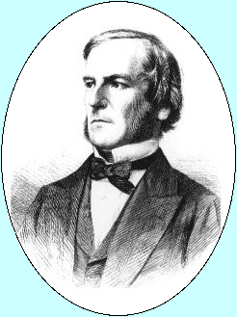
Boolean Expressions
In many ways, the most important primitive type in Java is boolean, even though it is by far the simplest. The only values in the boolean domain are true and false, but these are exactly the values you need if you want your program to make decisions.
The name boolean comes from the English mathematician George Boole who in 1854 wrote a book entitled An Investigation into the Laws of Thought, on Which are Founded the Mathematical Theories of Logic and Probabilities. That book introduced a system of logic that has come to be known as Boolean algebra, which is the foundation for the boolean data type.
George Boole (1791-1871)

Slide 11
Boolean Operators
The operators used with the boolean data type fall into two categories: relational operators and logical operators.
There are six relational operators that compare values of other types and produce a boolean result:
= =
Equals
!=
Not equals
<
Less than
<=
Less than or equal to
>
Greater than
>=
Greater than or equal to
For example, the expression n <= 10 has the value true if x is less than or equal to 10 and the value false otherwise.
There are also three logical operators:
&&
Logical AND
p && q means both p and q
||
Logical OR
p || q means either p or q (or both)
!
Logical NOT
!p means the opposite of p

Slide 12
Notes on the Boolean Operators
Remember that Java uses = to denote assignment. To test whether two values are equal, you must use the = = operator.
It is not legal in Java to use more than one relational operator in a single comparison as is often done in mathematics. To express the idea embodied in the mathematical expression
0 ≤ x ≤ 9
you need to make both comparisons explicit, as in
0 <= x && x <= 9
The || operator means either or both, which is not always clear in the English interpretation of or.
Be careful when you combine the ! operator with && and || because the interpretation often differs from informal English.

Slide 13
Short-Circuit Evaluation
Java evaluates the && and || operators using a strategy called short-circuit mode in which it evaluates the right operand only if it needs to do so.
For example, if n is 0, the right hand operand of && in
n != 0 && x % n == 0
is not evaluated at all because n != 0 is false. Because the expression
false && anything
is always false, the rest of the expression no longer matters.
One of the advantages of short-circuit evaluation is that you can use && and || to prevent execution errors. If n were 0 in the earlier example, evaluating x % n would cause a “division by zero” error.

Slide 14
The if Statement
The simplest of the control statements is the if statement, which occurs in two forms. You use the first form whenever you need to perform an operation only if a particular condition is true:
if (condition) {
statements to be executed if the condition is true
}
You use the second form whenever you want to choose between two alternative paths, one for cases in which a condition is true and a second for cases in which that condition is false:
if (condition) {
statements to be executed if the condition is true
} else {
statements to be executed if the condition is false
}

Slide 15
Common Forms of the if Statement
The examples in the book use only the following forms of the if statement:
Single line if statement
Multiline if statement with curly braces
if (condition) statement
if (condition) {
statement
. . . more statements . . .
}
if/else statement with curly braces
Cascading if statement
if (condition) {
statements_{true}
} else {
statements_{false}
}
if (condition₁) {
statements₁
} else if (condition₂) {
statements₂
. . . more else/if conditions . . .
} else {
statements_{else}
}

Slide 16
The ?: Operator
In addition to the if statement, Java provides a more compact way to express conditional execution that can be extremely useful in certain situations. This feature is called the ?: operator (pronounced question-mark-colon) and is part of the expression structure. The ?: operator has the following form:
condition ? expression₁ : expression₂
When Java evaluates the ?: operator, it first determines the value of condition, which must be a boolean. If condition is true, Java evaluates expression₁ and uses that as the value; if condition is false, Java evaluates expression₂ instead.
You could use the ?: operator to assign the larger of x and y to the variable max like this:
max = (x > y) ? x : y;

Slide 17
The switch Statement
The switch statement provides a convenient syntax for choosing among a set of possible paths:
When Java executes a switch statement, it begins by evaluating expression, which must produce an integer-like value.
Java then looks for a case clause that matches expression. If expression was equal to v₂, Java would choose the second clause.
Java evaluates the statements in a case clause until it reaches the break statement, which should appear at the end of each clause.
If none of the values in the case clauses match the expression, Java evaluates the statements in the default clause.
The switch statement provides a convenient syntax for choosing among a set of possible paths:
switch ( expression ) {
case v₁:
statements to be executed if expression = v₁
break;
case v₂:
statements to be executed if expression = v₂
break;
. . . more case clauses if needed . . .
default:
statements to be executed if no values match
break;
}
switch ( expression ) {
case v₁:
statements to be executed if expression = v₁
break;
case v₂:
statements to be executed if expression = v₂
break;
. . . more case clauses if needed . . .
default:
statements to be executed if no values match
break;
}

Slide 18
Example of the switch Statement
The switch statement is useful when the program must choose among several cases, as in the following example:
public void run() {
println(This program shows the number of days in a month.");
int month = readInt("Enter numeric month (Jan=1): ");
switch (month) {
case 2:
println("28 days (29 in leap years)");
break;
case 4: case 6: case 9: case 11:
println("30 days");
break;
case 1: case 3: case 5: case 7: case 8: case 12:
println("31 days");
break;
default:
println("Illegal month number");
break;
}
}

Slide 19
The while Statement
The while statement is the simplest of Java’s iterative control statements and has the following form:
while ( condition ) {
statements to be repeated
}
while ( condition ) {
statements to be repeated
}
When Java encounters a while statement, it begins by evaluating the condition in parentheses, which must have a boolean value.
If the value of condition is true, Java executes the statements in the body of the loop.
At the end of each cycle, Java reevaluates condition to see whether its value has changed. If condition evaluates to false, Java exits from the loop and continues with the statement following the closing brace at the end of the while body.

Slide 20
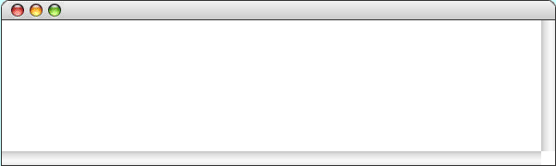
The DigitSum Program
public void run() {
println("This program sums the digits in an integer.");
int n = readInt("Enter a positive integer: ");
int dsum = 0;
while ( n > 0 ) {
dsum += n % 10;
n /= 10;
}
println("The sum of the digits is " + dsum);
}
public void run() {
println("This program sums the digits in an integer.");
int n = readInt("Enter a positive integer: ");
int dsum = 0;
while ( n > 0 ) {
dsum += n % 10;
n /= 10;
}
println("The sum of the digits is " + dsum);
}
public void run() {
println("This program sums the digits in an integer.");
int n = readInt("Enter a positive integer: ");
int dsum = 0;
while ( n > 0 ) {
dsum += n % 10;
n /= 10;
}
println("The sum of the digits is " + dsum);
}
n
n
dsum
dsum
1
0
0
1729
172
17
18
19
19
0
9
11
DigitSum
This program sums the digits in an integer.
1729
Enter a positive integer:
The sum of the digits is 19.
skip simulation

Slide 21
The for Statement
The for statement in Java is a particularly powerful tool for specifying the control structure of a loop independently from the operations the loop body performs. The syntax looks like this:
for ( init ; test ; step ) {
statements to be repeated
}
for ( init ; test ; step ) {
statements to be repeated
}
Java evaluates a for statement by executing the following steps:
1.
Evaluate init, which typically declares a control variable.
2.
Evaluate test and exit from the loop if the value is false.
3.
Execute the statements in the body of the loop.
4.
Evaluate step, which usually updates the control variable.
5.
Return to step 2 to begin the next loop cycle.

Slide 22
Comparing for and while
The for statement
for ( init ; test ; step ) {
statements to be repeated
}
is functionally equivalent to the following code using while:
init;
while ( test ) {
statements to be repeated
step;
}
The advantage of the for statement is that everything you need to know to understand how many times the loop will run is explicitly included in the header line.

Slide 23
Exercise: Reading for Statements
Describe the effect of each of the following for statements:
1.
for (int i = 1; i <= 10; i++)
This statement executes the loop body ten times, with the control variable i taking on each successive value between 1 and 10.
2.
for (int i = 0; i < N; i++)
This statement executes the loop body N times, with i counting from 0 to N - 1. This version is the standard Repeat-N-Times idiom.
3.
for (int n = 99; n >= 1; n -= 2)
This statement counts backward from 99 to 1 by twos.
4.
for (int x = 1; x <= 1024; x *= 2)
This statement executes the loop body with the variable x taking on successive powers of two from 1 up to 1024.

Slide 24
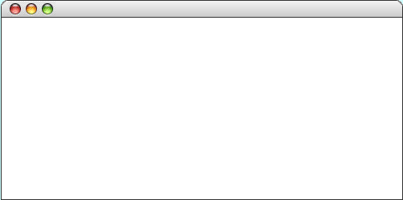
The Checkerboard Program
public void run() {
double sqSize = (double) getHeight() / N_ROWS;
for (int i = 0; i < N_ROWS; i++) {
for (int j = 0; j < N_COLUMNS; j++) {
double x = j * sqSize;
double y = i * sqSize;
GRect sq = new GRect(x, y, sqSize, sqSize);
sq.setFilled((i + j) % 2 != 0);
add(sq);
}
}
}
public void run() {
double sqSize = (double) getHeight() / N_ROWS;
for (int i = 0; i < N_ROWS; i++) {
for (int j = 0; j < N_COLUMNS; j++) {
double x = j * sqSize;
double y = i * sqSize;
GRect sq = new GRect(x, y, sqSize, sqSize);
sq.setFilled((i + j) % 2 != 0);
add(sq);
}
}
}
Execute the inner loop seven times to complete the checkerboard.
Execute these statements six more times to complete the row.
sqSize
sqSize
i
i
j
j
x
x
y
y
sq
sq
30.0
30.0
0
1
8
0
1
2
8
8
0.0
30.0
60.0
210.0
210.0
0.0
210.0
8
210.0
Checkerboard
skip simulation

Slide 25
Simple Graphical Animation
The while and for statements make it possible to implement simple graphical animation. The basic strategy is to create a set of graphical objects and then execute the following loop:
for (int i = 0; i < N_STEPS; i++) {
update the graphical objects by a small amount
pause(PAUSE_TIME);
}
for (int i = 0; i < N_STEPS; i++) {
update the graphical objects by a small amount
pause(PAUSE_TIME);
}
On each cycle of the loop, this pattern updates each animated object by moving it slightly or changing some other property of the object, such as its color. Each cycle is called a time step.
After each time step, the animation pattern calls pause, which delays the program for some number of milliseconds (expressed here as the constant PAUSE_TIME). Without the call to pause, the program would finish faster than the human eye can follow.

Slide 26

The AnimatedSquare Program
public void run() {
GRect square = new GRect(0, 0, SQUARE_SIZE, SQUARE_SIZE);
square.setFilled(true);
square.setFillColor(Color.RED);
add(square);
double dx = (getWidth() - SQUARE_SIZE) / N_STEPS;
double dy = (getHeight() - SQUARE_SIZE) / N_STEPS;
for (int i = 0; i < N_STEPS; i++) {
square.move(dx, dy);
pause(PAUSE_TIME);
}
}
public void run() {
GRect square = new GRect(0, 0, SQUARE_SIZE, SQUARE_SIZE);
square.setFilled(true);
square.setFillColor(Color.RED);
add(square);
double dx = (getWidth() - SQUARE_SIZE) / N_STEPS;
double dy = (getHeight() - SQUARE_SIZE) / N_STEPS;
for (int i = 0; i < N_STEPS; i++) {
square.move(dx, dy);
pause(PAUSE_TIME);
}
}
i
i
dx
dx
dy
dy
square
square
101
3.0
3.0
1.7
1.7
AnimatedSquare
AnimatedSquare
AnimatedSquare
skip simulation

Slide 27
The End

